Slide 1


ECEN 404
Creating STEM Contents: Solar Power with a Tracking System
Status Update #3
Leo Predanic
George Thuita
Brandon Cenci
Sponsor: Dr. Won Jang
TA: Souryendu Das

Slide 2

Executive Summary
Problem statement:
To create the future of tomorrow, we must invest today - by getting students interested in STEM early
Our Solution:
Excite K-12 students by creating a portable solar system for demonstration purposes
Contain digestible figures & animations to describe/track system

Slide 3
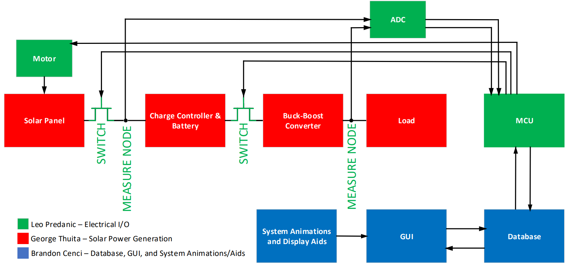
System Flow & Overview

Slide 4
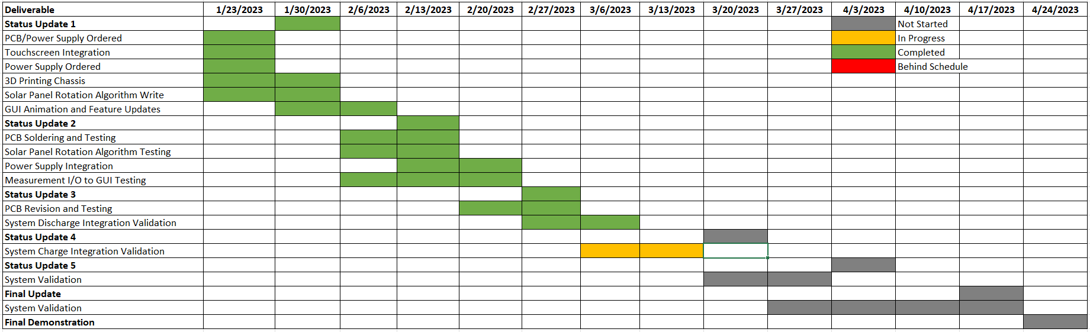
Execution

Slide 5
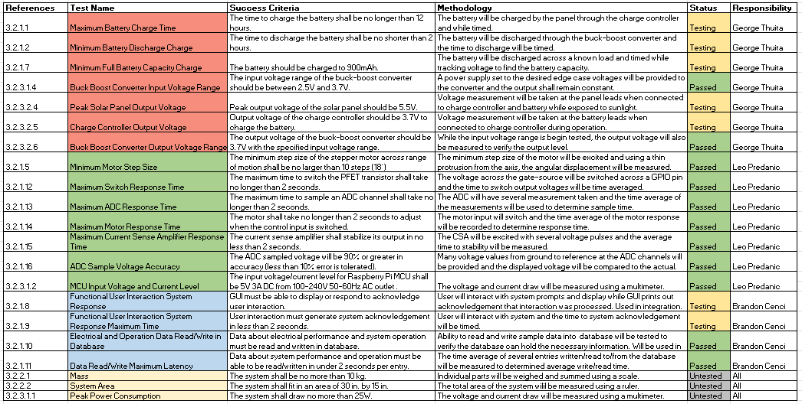
Validation

Slide 6
Solar Power Generation-Electrical I/O George Thuita/Leo Predanic
Accomplishments since last presentation 25 hrs | Ongoing progress/problems and plans until next presentation
-PCB 100% Soldered -Can switch between loads -Can take voltage/current (power) measurements -Integrated GUI with PCB, can display/interact with measurements -Working on charge side testing and validation -Initial user interaction integrated | -Issue with FET isolation, when FET is supposed to be off, it’s not off -Will be removing this FET, no longer need it -Finish solar charging testing -Addition of complete user interaction to PCB operation

Slide 7
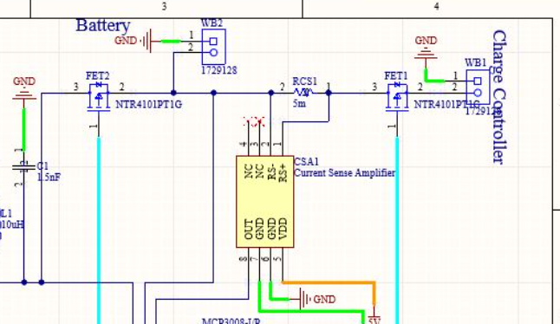
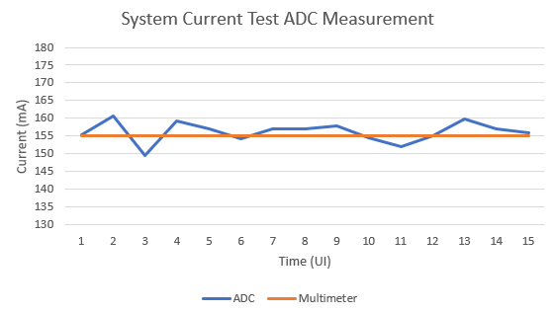
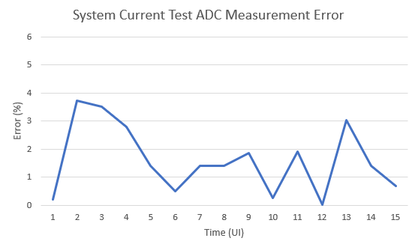
Solar Power Generation-Electrical I/O (2) George Thuita/Leo Predanic

Slide 8
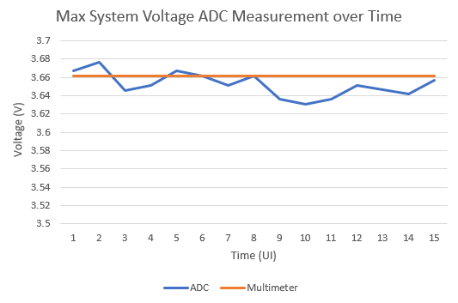
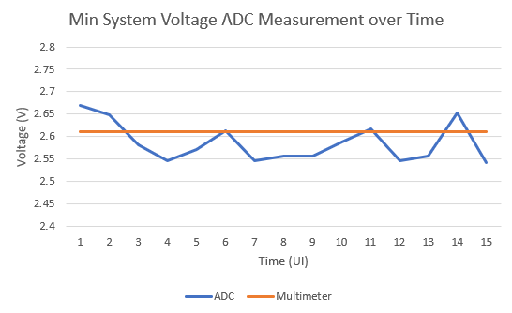
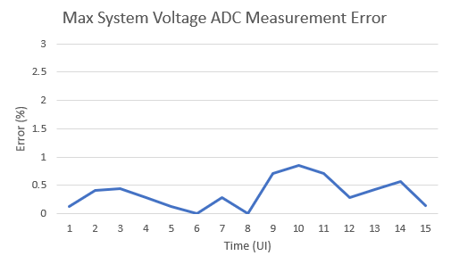
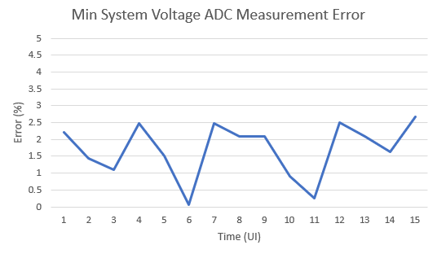
Solar Power Generation-Electrical I/O (2) George Thuita/Leo Predanic

Slide 9
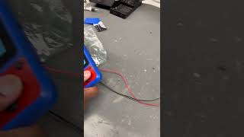
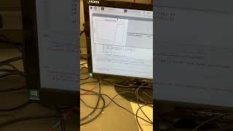
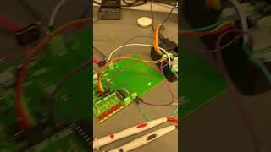
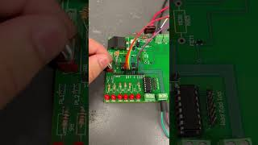
Solar Power Generation-Electrical I/O (3) George Thuita/Leo Predanic
Real Time GUI Measurements
FET Switching Load
Voltage/Current/Power Sensing
Load Switching

Slide 10
GUI and Database-Electrical I/O Brandon Cenci/Leo Predanic
Accomplishments since last presentation 20 hrs | Ongoing progress/problems and plans until next presentation
-Validated reading measurements from ADC and properly updating values - Worked on integrating long-term graph with database interaction - Began testing GUI to motor/PFET output signals - Updated GUI with additional capability to control user input/output - Tested possibility of multithreading to manage motor control | - Explore additional opportunity for optimizing threading on Linux - Adding motor control to GUI - Finish validation on GUI response times to ensure smooth operation -Additional GUI formatting/cleaning
Thread 1
GUI to Motor
Periodic Update
GUI
Generation/Update
Thread 2?
ADC/Data
Collection
(Python Tkinter Main Loop)

Slide 11
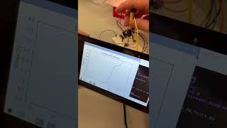
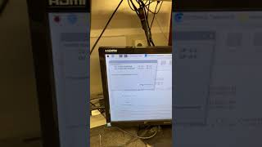
GUI and Database-Electrical I/O (2) Brandon Cenci/Leo Predanic
Real Time GUI Measurement - Test Circuit with Potentiometer
Real Time User Interaction - PCB Integration

Slide 12
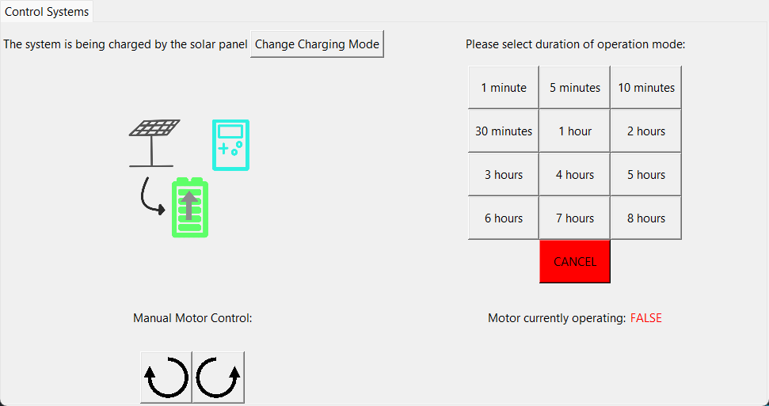
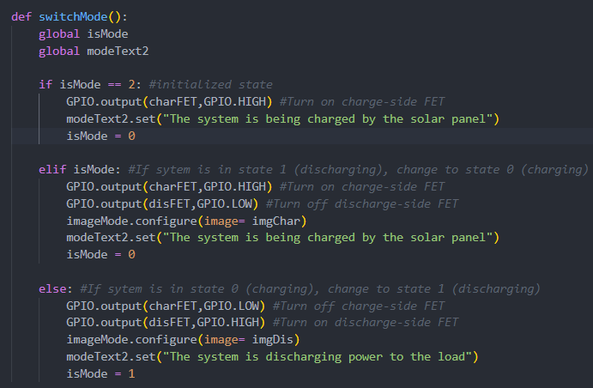
GUI and Database-Electrical I/O (3) Brandon Cenci/Leo Predanic

Slide 13
Thank You!
Questions?

